Slide 1


BlizzardX
Cracking the Code of Snow & Temperature Swings
TEAM H: Lokeshwar Kudumula
Namruth Goud Thimmapuram
Hema Pushpika Konduru
Sree Sai Preetham Kadiyam

Slide 2
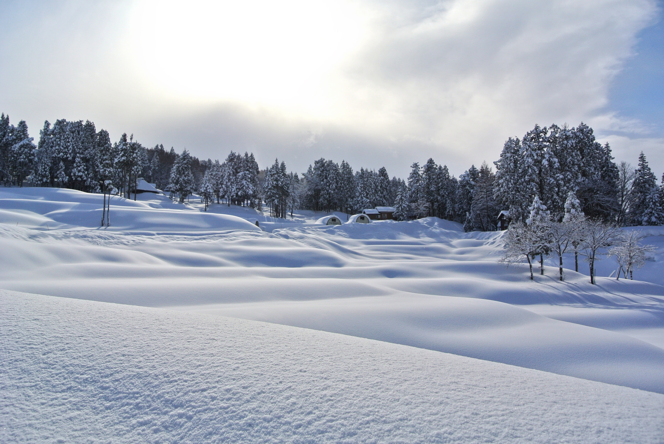
Introduction to the Project
What is the project about?
Exploring the relationship between snowfall, snow depth, and temperature fluctuations.
Predicting temperature changes and extreme cold events using machine learning.
Why is this project chosen?
Extreme cold events have significant impacts on agriculture, urban planning, and emergency preparedness.
Accurate predictions can help mitigate risks and improve decision-making.
Research Question:
How does snowfall and snow depth influence temperature fluctuations?
Can machine learning models predict temperature changes and extreme cold events with high accuracy?

Slide 3

Overview of Similar Approaches
State of the Art:
Many studies focus on temperature prediction using weather data, but few integrate snowfall and snow depth as key features.
Existing models often use traditional statistical methods rather than advanced machine learning techniques.
What’s Missing?
Limited focus on the impact of snowfall and snow depth on microclimates.
Few studies predict the duration and intensity of extreme cold events.
How is your project different?
We integrate snowfall and snow depth as key features.
We use advanced machine learning models (e.g., LSTM, XGBoost) for both regression and classification tasks.
We aim to predict not just the occurrence of extreme cold events but also their duration and intensity.

Slide 4
Dataset Introduction
Dataset Source: NOAA’s GHCN-Daily dataset.
Dataset Link: ncei.noaa.gov
Dataset Description:
Size: ~129,648 station records worldwide.
Attributes:
Snowfall (SNOW)
Snow Depth (SNWD)
Maximum Temperature (TMAX)
Minimum Temperature (TMIN)
PRCP(Precipitation (tenths of mm))
Station Metadata (Latitude, Longitude, Elevation)
Machine Learning Tasks:
Regression: Predict temperature changes (TMAX, TMIN).
Classification: Predict extreme cold events (binary classification).

Slide 5

Exploratory Data Analysis (EDA)
Key Insights from EDA:
Missing Data by Year for Each Station:
Some stations in New Hampshire have missing data for certain years (e.g., 1894, 1904, 1914, etc.).
Implication:
Focus on stations with complete data or use data imputation techniques to fill gaps.
2. Location of Stations in New Hampshire
The map highlights weather stations in New Hampshire, a region known for its snowfall and temperature fluctuations.
Implication:
New Hampshire’s climate is ideal for studying the relationship between snowfall, snow depth, and temperature.
3. Snow Fall Percentage
This bar graph visualizes the average snowfall percentage recorded by all the stations through the years from 1894 to 2024.
Each pin on the map represents an active station in the state in which all the weather changes are recorded.

Slide 6
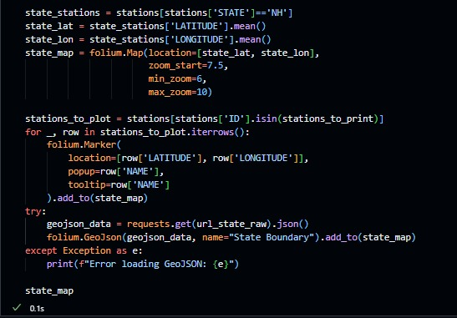
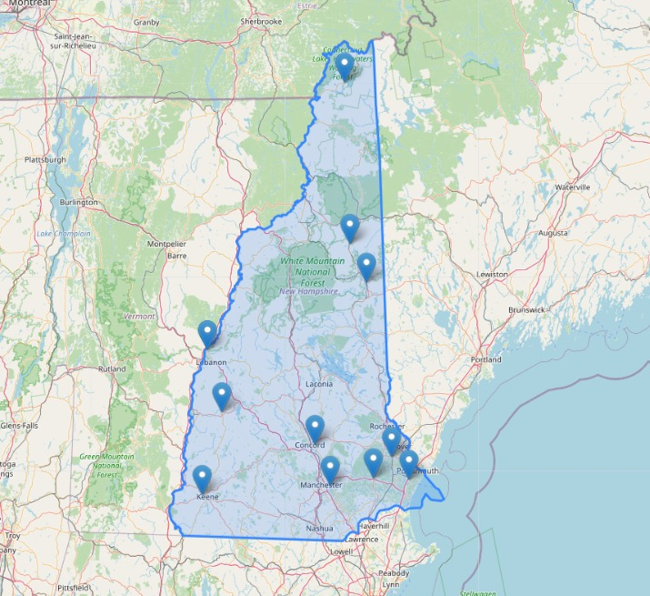
Mapping of NH Active Weather stations

Slide 7
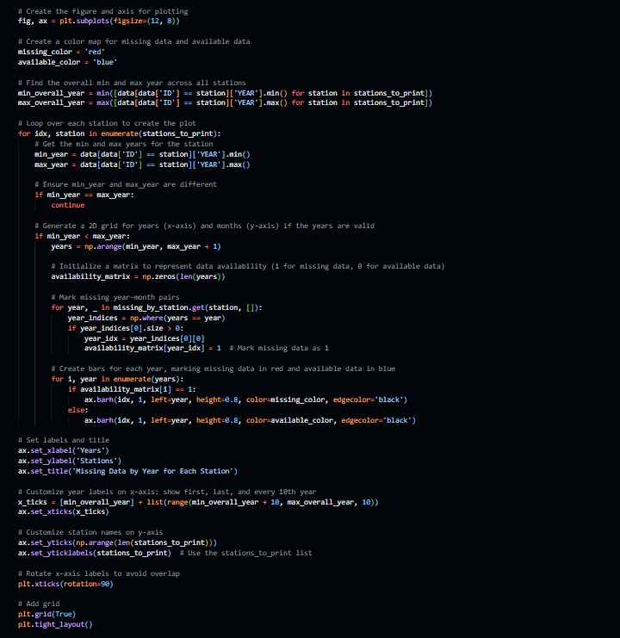
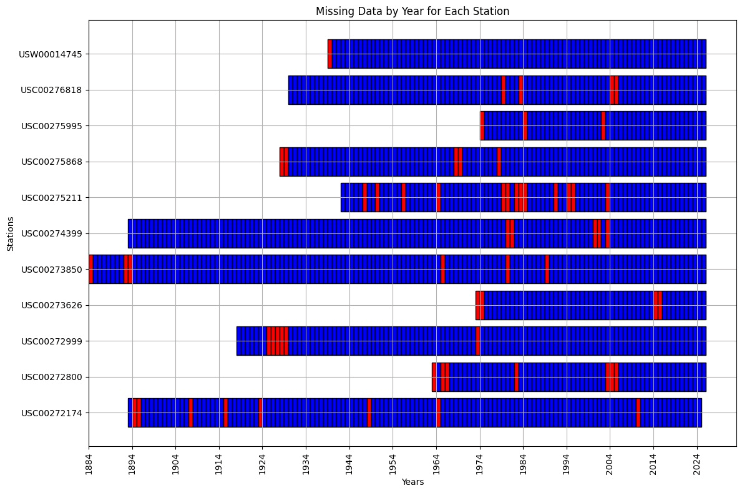
Missing Data by year(1894 to 2024)

Slide 8
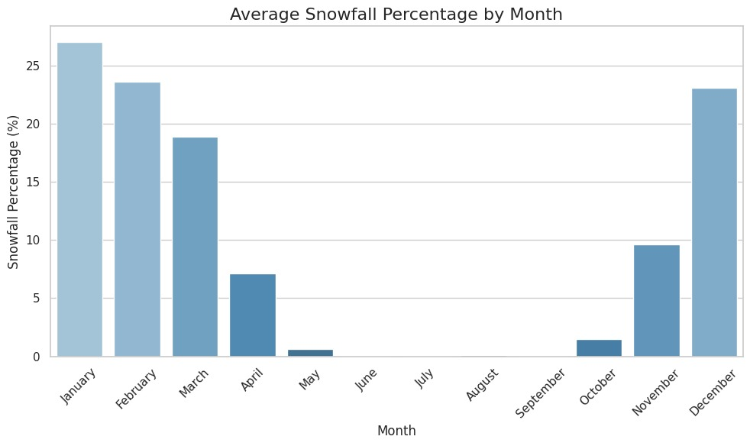
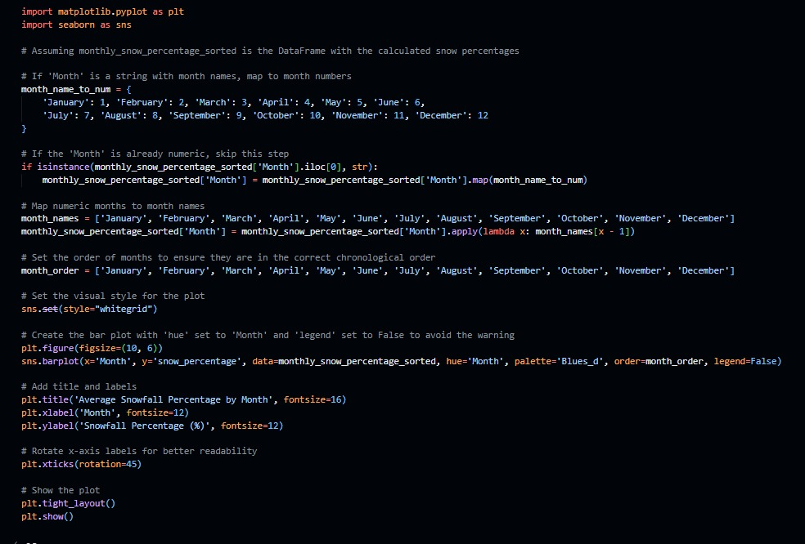
Snow fall percentage on Average by month (1894 to 2024)

Slide 9
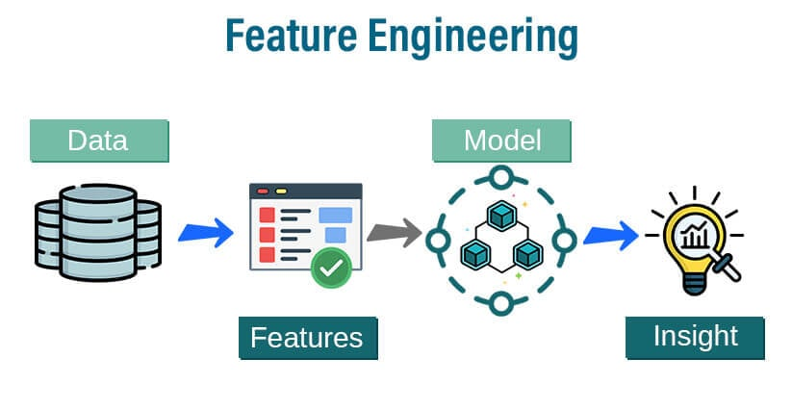
Proposed Methodology
Feature Engineering:
Temporal features (e.g., lagged variables, rolling averages).
Geospatial features (e.g., latitude, longitude, elevation).
Machine Learning Models:
Regression Models: Gradient Boosting Regressor, LSTM.
Classification Models: Logistic Regression, XGBoost.
Evaluation Metrics:
Regression: R² Score, RMSE.
Classification: Accuracy, F1-Score, Confusion Matrix.

Slide 10

Differentiation from Existing Work
What makes your approach unique?
Integration of snowfall and snow depth as key features.
Use of advanced machine learning models (e.g., LSTM for time-series data).
Prediction of both occurrence and duration/intensity of extreme cold events.
Potential Impact:
Improved accuracy in weather forecasting.
Better preparedness for extreme cold events in agriculture, urban planning, and emergency response.

Slide 11

1. Weather Forecasting:
Improve accuracy in predicting extreme cold events.
Help meteorologists provide more reliable forecasts.
2. Emergency Preparedness:
Enable better planning for severe winter conditions.
Reduce risks to public health and safety.
3. Urban Planning:
Help cities adapt infrastructure to handle extreme cold.
Improve road maintenance and energy distribution.
4. Agriculture:
Mitigate frost damage to crops.
Provide farmers with accurate frost forecasts.

Slide 12

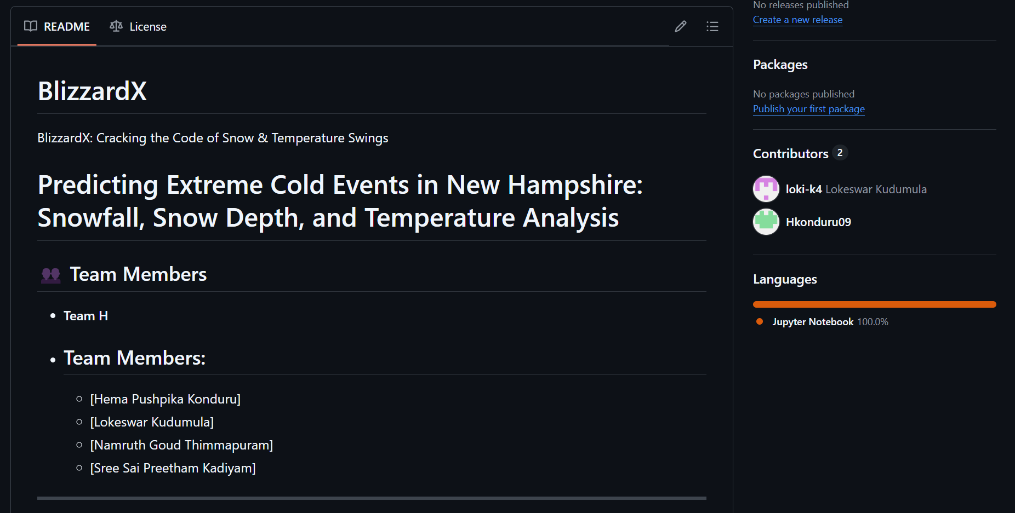
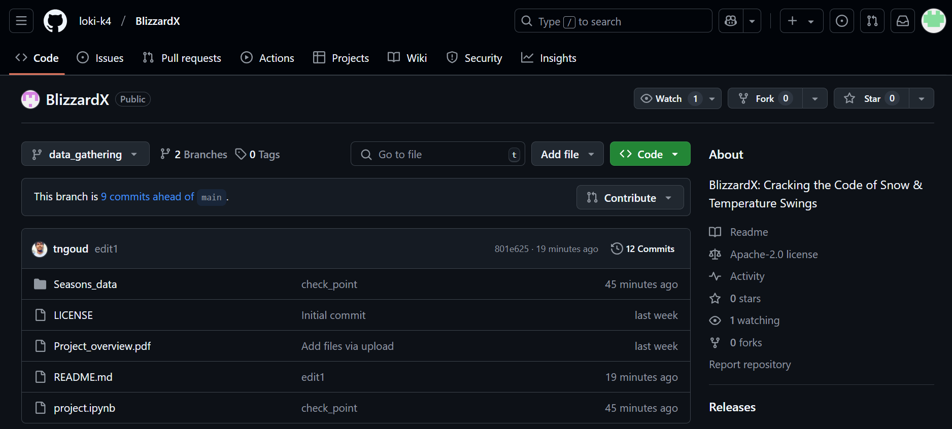
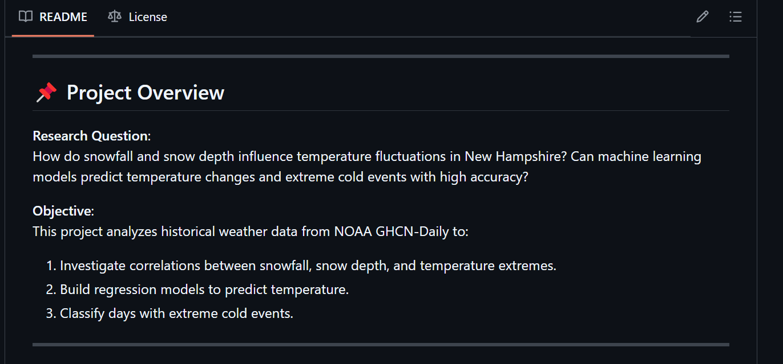
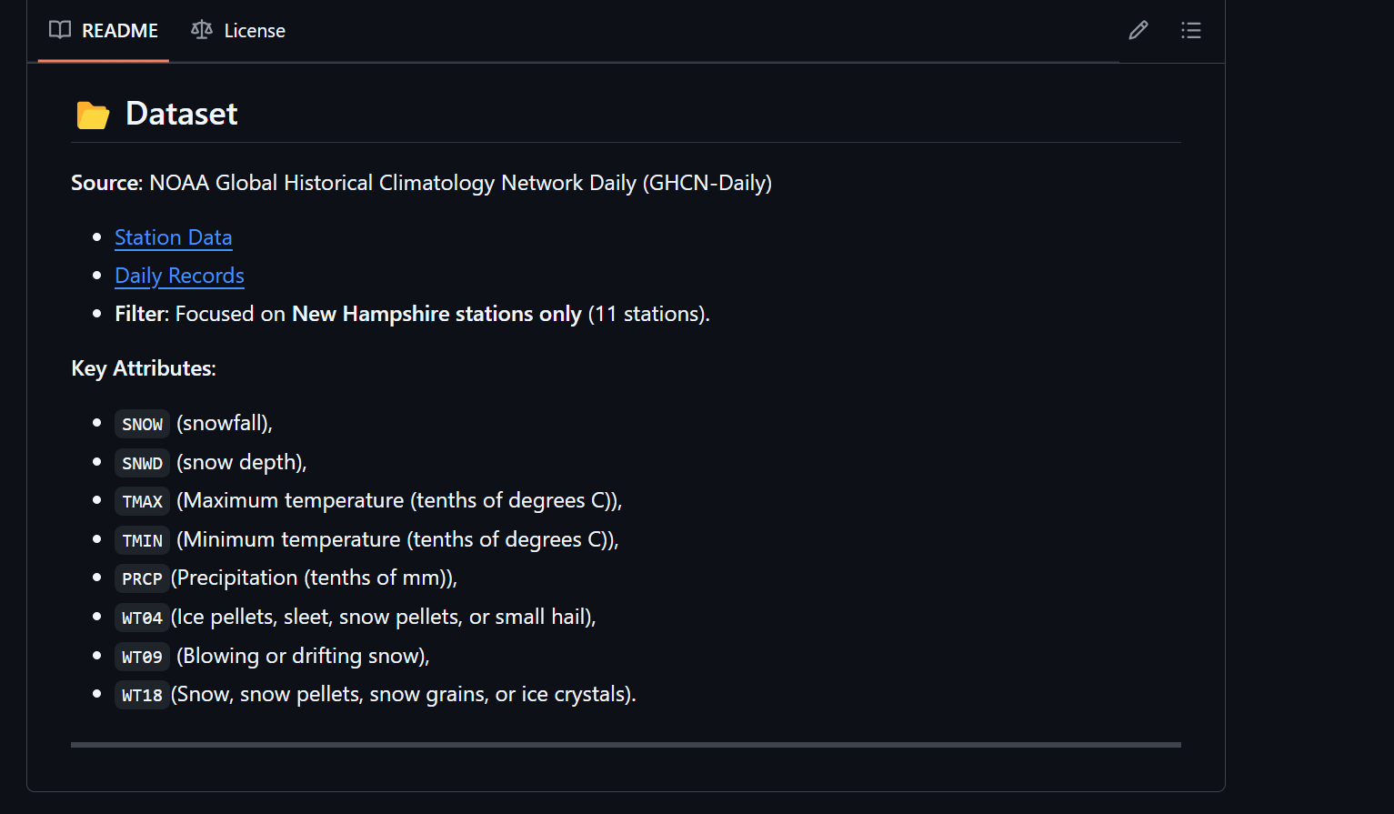
GitHub Repository: BlizzardX

Slide 13

Key References
Khan, H., Chandravat, U., Department of Electronics and communication, & Acropolis institute of technology and science. (2023). Environmental Temperature Prediction using IoT-based Machine Learning Technique for Agriculture. Journal of Emerging Technologies and Innovative Research, 10(1). jetir.org
Marta, S., Zimmer, A., Caccianiga, M., Gobbi, M., Ambrosini, R., Azzoni, R. S., Gili, F., Pittino, F., Thuiller, W., Provenzale, A., & Ficetola, G. F. (2023). Heterogeneous changes of soil microclimate in high mountains and glacier forelands. Nature Communications, 14(1). doi.org
Temperature Prediction using Machine Learning Approaches. (2019, July 1). IEEE Conference Publication | IEEE Xplore. ieee.org
Tyystjärvi, V., Niittynen, P., Kemppinen, J., Luoto, M., Rissanen, T., & Aalto, J. (2024). Variability and drivers of winter near-surface temperatures over boreal and tundra landscapes. the Cryosphere, 18(1), 403–423. doi.org
Vishwakarma, H. (2020). Climate change analysis using machine learning. In International Journal of Science and Research (IJSR) [Journal-article]. ijsr.net
Wilson, G., Green, M., Brown, J., Campbell, J., Groffman, P., Durán, J., & Morse, J. (2020). Snowpack affects soil microclimate throughout the year. Climatic Change, 163(2), 705–722. doi.org

Slide 14


